Slide 1
Introduction to Hadoop
Dr.Preethi Ananthachari
Asst.Professor
AI & Big Data
Endicott College of International Studies
Woosong University
Daejeon, South Korea

Slide 2
Hadoop
Is a Opensource frame work
It is provided by Apache to process and analyze very huge volume of data.
It is written in Java and currently used by Google, Facebook, LinkedIn, Yahoo, Twitter etc.

Slide 3
What is Big Data
Data which are very large in size is called Big Data.
Normally we work on data of size MB(WordDoc ,Excel) or maximum GB(Movies, Codes)
Data in Peta bytes i.e. 10^15 byte size is called Big Data.
It is stated that almost 90% of today's data has been generated in the past 3 years.

Slide 4
Sources of Big Data
Social networking sites: Facebook, Google, LinkedIn all these sites generates huge amount of data on a day to day basis as they have billions of users worldwide.
E-commerce site: Sites like Amazon, Flipkart, Alibaba generates huge amount of logs from which users buying trends can be traced.
Weather Station: All the weather station and satellite gives very huge data which are stored and manipulated to forecast weather.
Telecom company: Telecom giants like SKT, KT study the user trends and accordingly publish their plans and for this they store the data of its million users.
Share Market: Stock exchange across the world generates huge amount of data through its daily transaction.
Black Box Data − It is a component of helicopter, airplanes, and jets, etc. It captures voices of the flight crew, recordings of microphones and earphones, and the performance information of the aircraft.

Slide 5
3 V’s of Big Data
Velocity: The data is increasing at a very fast rate. It is estimated that the volume of data will double in every 2 years.
Variety: Now a days data are not stored in rows and column. Data is structured as well as unstructured. Log file, CCTV footage is unstructured data. Data which can be saved in tables are structured data like the transaction data of the bank.
Volume: The amount of data which we deal with is of very large size of Peta bytes.

Slide 6
Data types
Thus Big Data includes huge volume, high velocity, and extensible variety of data. The data in it will be of three types.
Structured data − Relational data.
Semi Structured data − XML data.
Unstructured data − Word, PDF, Text, Media Logs.

Slide 7
Big Data Technologies
Big data technologies are important in providing more accurate analysis, which may lead to more concrete decision-making resulting in greater operational efficiencies, cost reductions, and reduced risks for the business.
2 types
Operational Big Data
Analytical Big Data

Slide 8
Operational Big Data
MongoDB that provide operational capabilities for real-time, interactive workloads where data is primarily captured and stored
NoSQL Big Data systems are designed to take advantage of new cloud computing architectures

Slide 9
Analytical Big Data
These includes systems like Massively Parallel Processing (MPP) database systems and MapReduce that provide analytical capabilities for retrospective and complex analysis that may touch most or all of the data.

Slide 10
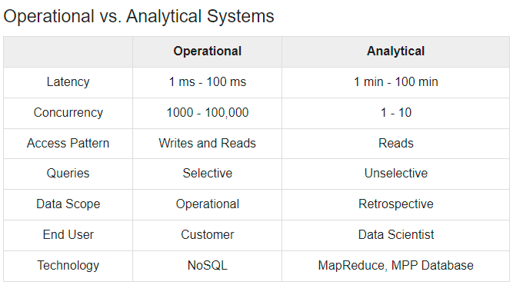

Slide 11
Use Case
An e-commerce site XYZ (having 100 million users) wants to offer a gift voucher of 100$ to its top 10 customers who have spent the most in the previous year. Moreover, they want to find the buying trend of these customers so that company can suggest more items related to them.
Issues:
Huge amount of unstructured data which needs to be stored, processed and analyzed.

Slide 12
Traditional Approach
An enterprise will have a computer to store and process big data.
For storage purpose, the programmers will take the help of their choice of database vendors such as Oracle, IBM, etc.
In this approach, the user interacts with the application, which in turn handles the part of data storage and analysis.

Slide 13
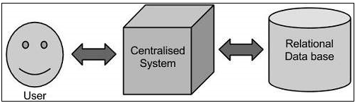
Traditional Approach

Slide 14
Google Solution
Google solved this problem using an algorithm called MapReduce.
This algorithm divides the task into small parts and assigns them to many computers, and collects the results from them which when integrated, form the result dataset.

Slide 15
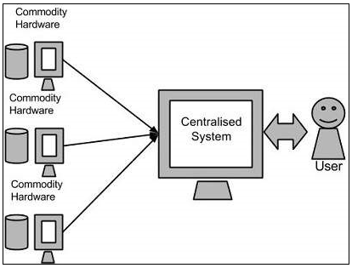
Google Solution

Slide 16
Hadoop Solution
Using the solution provided by Google, Doug Cutting and his team developed an Open Source Project called HADOOP.
Hadoop runs applications using the MapReduce algorithm, where the data is processed in parallel with others.
In short, Hadoop is used to develop applications that could perform complete statistical analysis on huge amounts of data.

Slide 17
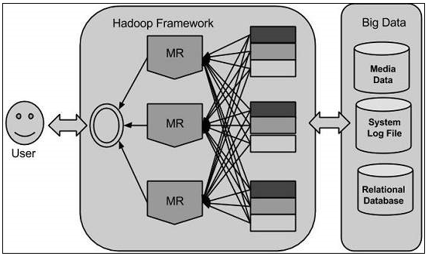
Hadoop

Slide 18
Solution
Storage: This huge amount of data, Hadoop uses HDFS (Hadoop Distributed File System) which uses commodity hardware to form clusters and store data in a distributed fashion. It works on Write once, read many times principle.
Processing: Map Reduce paradigm is applied to data distributed over network to find the required output.
Analyze: Pig, Hive can be used to analyze the data.
Cost: Hadoop is open source so the cost is no more an issue.

Slide 19
Hadoop
Hadoop is written in Java and is not OLAP (online analytical processing).
It is used for batch/offline processing.
Moreover it can be scaled up just by adding nodes in the cluster.

Slide 20
Modules of Hadoop
HDFS: Hadoop Distributed File System. Google published its paper GFS and on the basis of that HDFS was developed. It states that the files will be broken into blocks and stored in nodes over the distributed architecture.
Yarn: Yet another Resource Negotiator is used for job scheduling and manage the cluster.
Map Reduce: This is a framework which helps Java programs to do the parallel computation on data using key value pair. The Map task takes input data and converts it into a data set which can be computed in Key value pair. The output of Map task is consumed by reduce task and then the out of reducer gives the desired result.
Hadoop Common: These Java libraries are used to start Hadoop and are used by other Hadoop modules.

Slide 21
Hadoop Architecture
The Hadoop architecture is a package of the file system, MapReduce engine and the HDFS (Hadoop Distributed File System).
The MapReduce engine can be MapReduce/MR1 or YARN/MR2.
A Hadoop cluster consists of a single master and multiple slave nodes.
The master node includes Job Tracker, Task Tracker, NameNode, and DataNode whereas the slave node includes DataNode and TaskTracker.

Slide 22
How Does Hadoop Work?
It is quite expensive to build bigger servers with heavy configurations that handle large scale processing,
but as an alternative, you can tie together many commodity computers with single-CPU, as a single functional distributed system and practically,
the clustered machines can read the dataset in parallel and provide a much higher throughput.

Slide 23
Hadoop runs code across a cluster of computers.
This process includes the following core tasks that Hadoop performs −
Data is initially divided into directories and files. Files are divided into uniform sized blocks of 128M and 64M (preferably 128M).
These files are then distributed across various cluster nodes for further processing.
HDFS, being on top of the local file system, supervises the processing.
Blocks are replicated for handling hardware failure.
Checking that the code was executed successfully.
Performing the sort that takes place between the map and reduce stages.
Sending the sorted data to a certain computer.
Writing the debugging logs for each job.

Slide 24
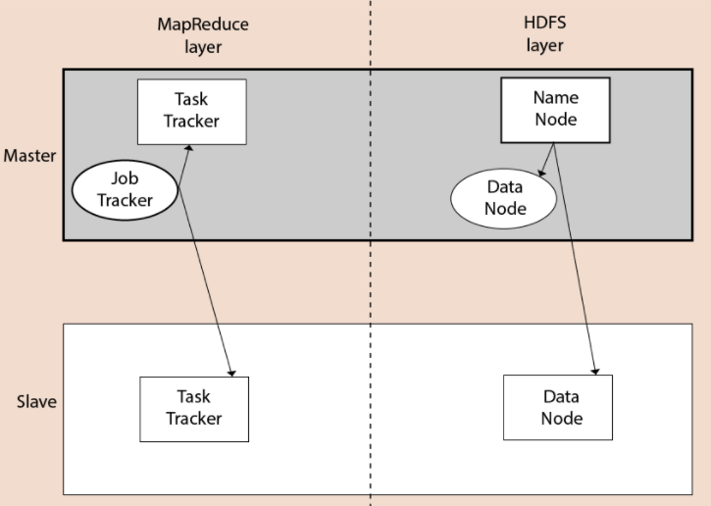
Block Diagram

Slide 25
Hadoop Distributed File System
The Hadoop Distributed File System (HDFS) is a distributed file system for Hadoop. It contains a master/slave architecture.
This architecture consist of a single NameNode performs the role of master, and multiple DataNodes performs the role of a slave.
Both NameNode and DataNode are capable enough to run on commodity machines.
The Java language is used to develop HDFS. So any machine that supports Java language can easily run the NameNode and DataNode software.

Slide 26
Name Node
It is a single master server exist in the HDFS cluster.
As it is a single node, it may become the reason of single point failure.
It manages the file system namespace by executing an operation like the opening, renaming and closing the files.
It simplifies the architecture of the system.

Slide 27
Data Node
The HDFS cluster contains multiple DataNodes.
Each DataNode contains multiple data blocks.
These data blocks are used to store data.
It is the responsibility of DataNode to read and write requests from the file system's clients.
It performs block creation, deletion, and replication upon instruction from the NameNode.

Slide 28
Job Tracker
The role of Job Tracker is to accept the MapReduce jobs from client and process the data by using NameNode.
In response, NameNode provides metadata to Job Tracker.
Task Tracker
It works as a slave node for Job Tracker.
It receives task and code from Job Tracker and applies that code on the file. This process can also be called as a Mapper.

Slide 29
How to overcome Hardware Failure?
As soon as you start using many pieces of hardware, the chance that one will fail is fairly high.
A common way of avoiding data loss is through replication: redundant copies of the data are kept by the system so that in the event of failure, there is another copy available.
This is how RAID works, for instance, although Hadoop’s filesystem, the Hadoop Distributed Filesystem (HDFS), takes a slightly different approach, as you shall see later.

Slide 30
Mapreduce
MapReduce is a batch query processor, and the ability to run an ad hoc query against your whole dataset and get the results in a reasonable time is transformative.

Slide 31
Comparison with Other Systems
Relational Database Management Systems
Why can’t we use databases with lots of disks to do large-scale analysis?
Why is Hadoop needed?
The answer to these questions comes from another trend in disk drives: seek time is improving more slowly than transfer rate.

Slide 32
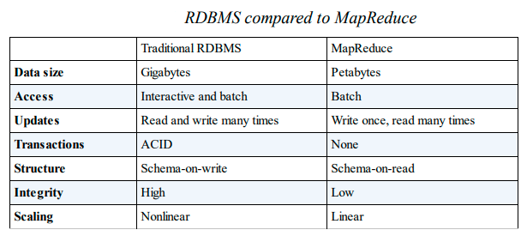

Slide 33
Hadoop systems such as Hive are becoming more interactive (by moving away from MapReduce) and adding features like indexes and transactions that make them look more and more like traditional RDBMSs.
Hadoop tries to co-locate the data with the compute nodes, so data access is fast because it is local.
This feature, known as data locality, is at the heart of data processing in Hadoop and is the reason for its good performance.

Slide 34
Reference
https://data-flair.training/blogs/hadoop-tutorial/

